Slide 1
BANG! AI Using Alpha-Beta Pruning
Barbara Martin
Elizabeth Phippen

Slide 2
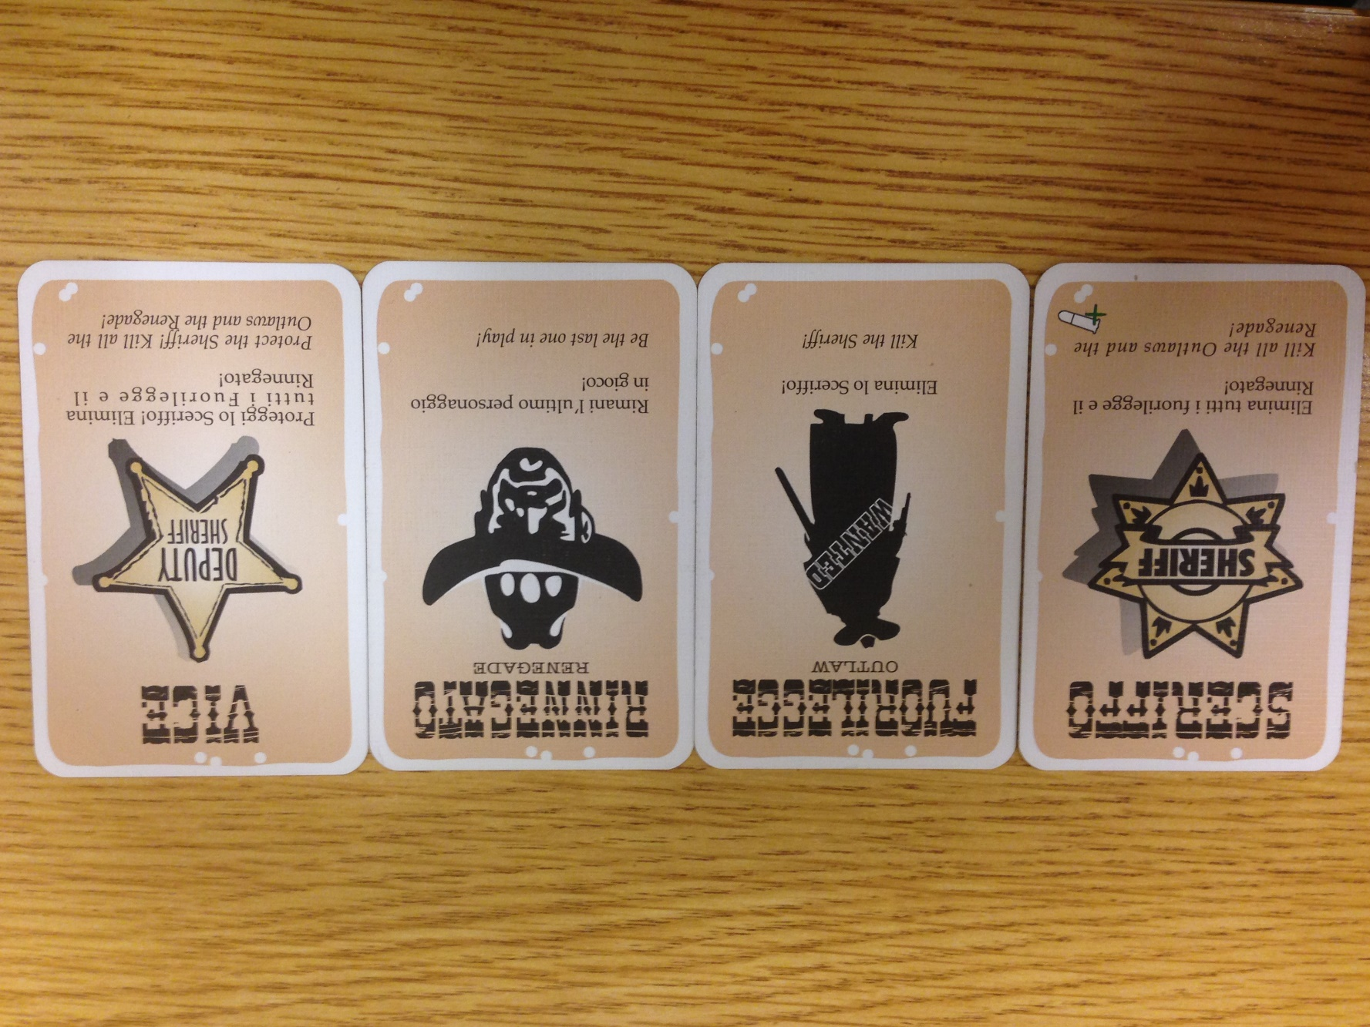
BANG!
Roles
Sheriff, Outlaw(x3), Renegade, Deputy(x2)
To win
Sheriff/Deputies have to kill the Outlaws and Renegade
Outlaws have to kill the Sheriff
Renegade has to kill everyone, saving the Sheriff for last
Turn
Draw 2 cards
Play/discard as many from hand as you want
Must end turn with hand <= health

Slide 3
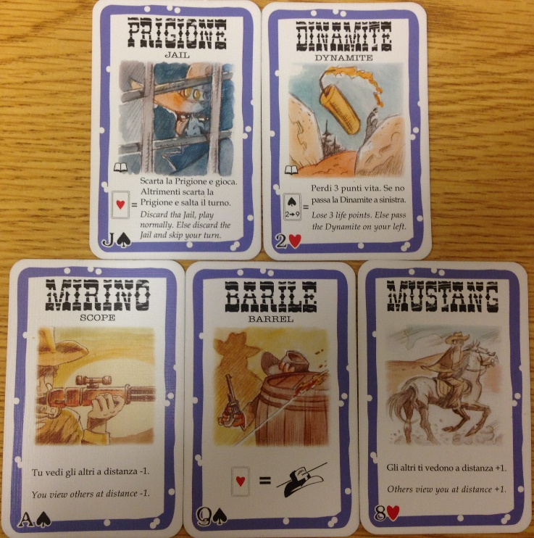
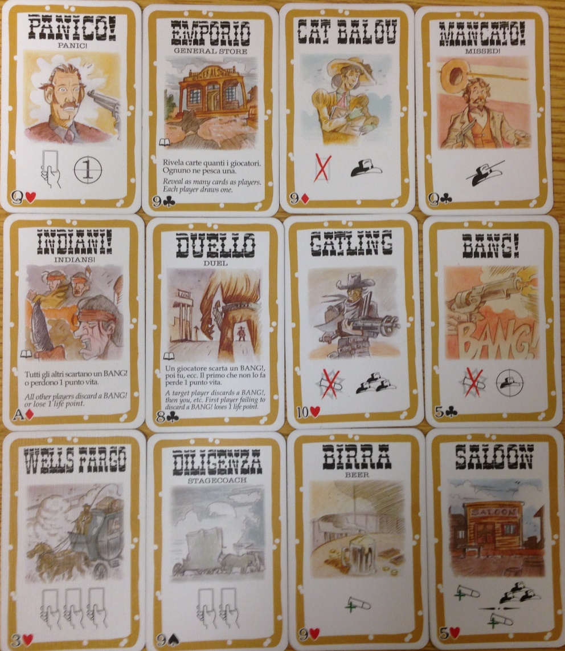
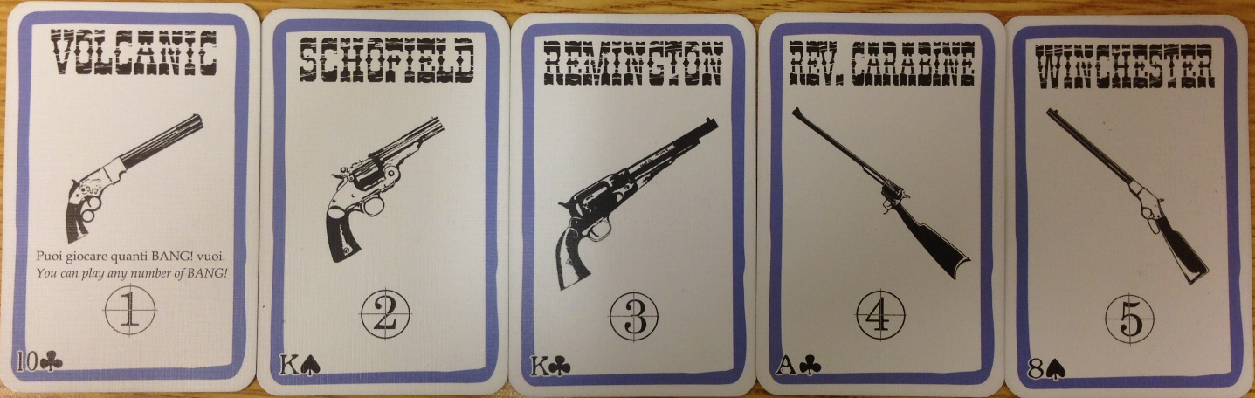
It gets Complicated…
22 Different Cards
Each with unique abilities and actions

Slide 4
Our Goal / Methodology
Construct a AI for BANG!
Initially Based on Bayesian Belief Network (BN)
Choose BN because Bang is a game of incomplete information
Roles remain hidden until a player is killed
E.g. Sheriff doesn’t want to shoot a deputy
BN handles probabilities well
Language: Python
Flexible and has BN module
bayespy

Slide 5
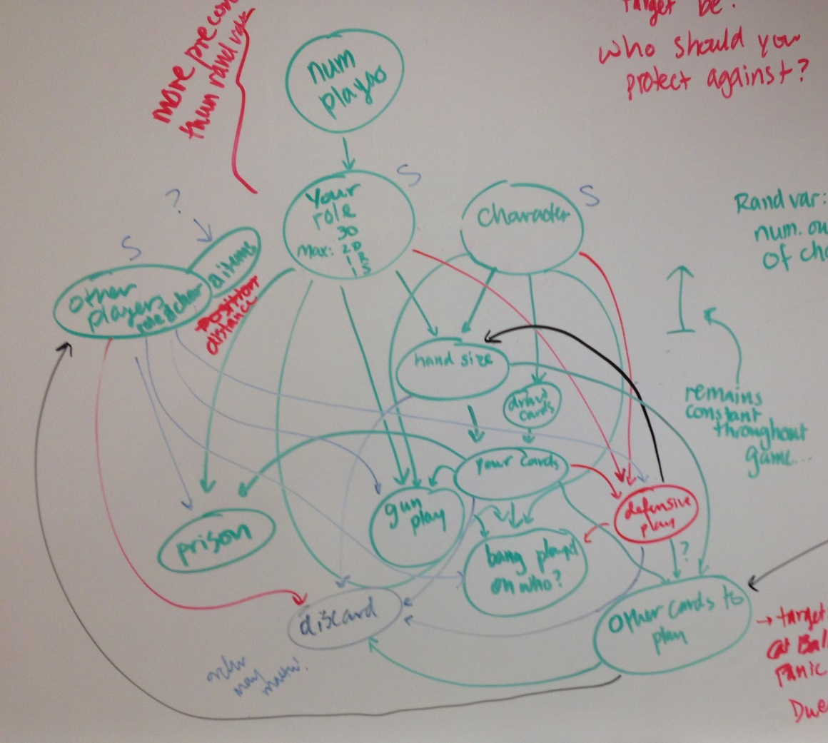
Methodology
Game Construction
Complicated rule logic
Slight language barrier
SimpleAI for Comparison
plays every card possible on self and person to the left
BN construction
Drew model
Split in to manageable steps
Then we hit problems…

Slide 6
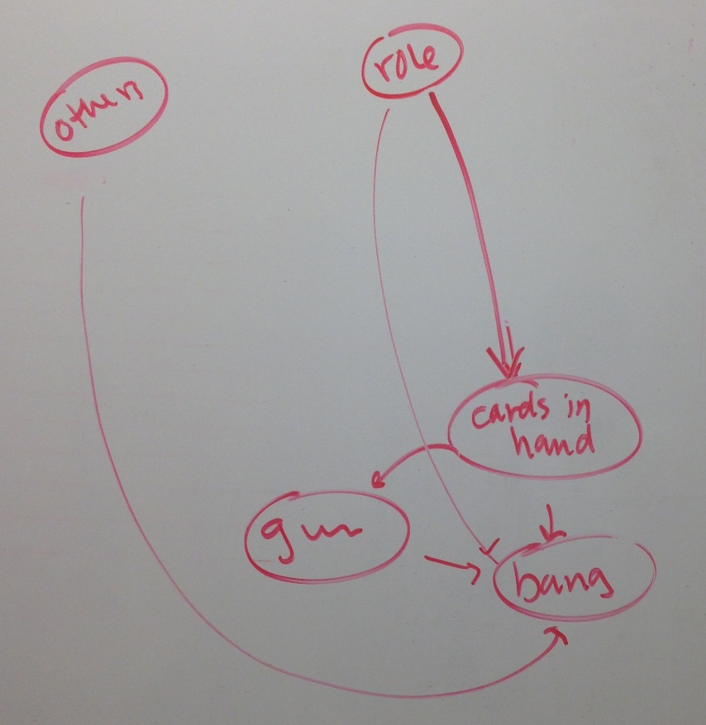
Methodology
Game Construction
Complicated rule logic
Slight language barrier
SimpleAI for Comparison
plays every card possible on self and person to the left
BN construction
Drew model
Split in to manageable steps
Then we hit problems…

Slide 7
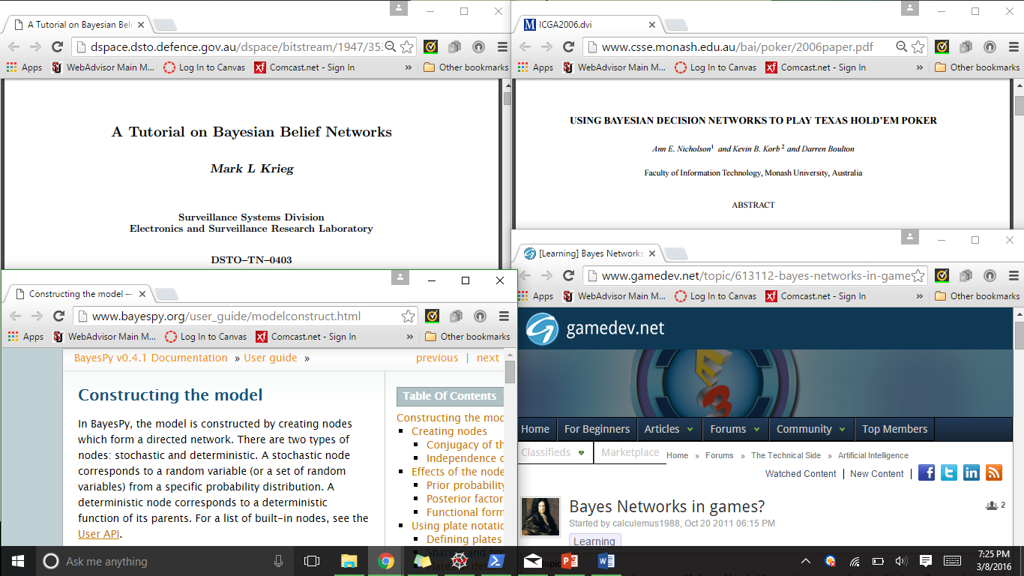
Methodology
Couldn’t find enough information about bayespy to use it
read peer-reviewed papers and web articles
Read bayespy documentation
Switched to Alpha-Beta Pruning
Complex heuristic could account for complexity of influential data
Could also account for unknown information
Assumption: Unknown = Enemy

Slide 8
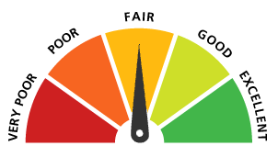
Methodology
Score Function
Am I dead?
Who is dead and do I want them to be?
Have I won?
How many players are in range of my gun?
Good and bad status cards?
My health and other’s health?
How many players can shoot me?

Slide 9

Methodology
Ran 50 trials of four samples:
Sample 1: all “Dumb AI”
Sample 2: all “Alpha-Beta AI”, ply 0
Sample 3: all “Alpha-Beta AI”, ply 4
Sample 4: all “Alpha-Beta AI”, ply 10
4 people per game
Calculated proportion of wins for sheriff, outlaws, renegades
Wanted to do large sample runs, but didn’t have time
Ideally: Run games with both Alpha-Beta and Dumb AI to see proportion of wins going to one or other

Slide 10
Results
Performed basic two-sided hypothesis testing:
Null: probability equal to random chance (0.25, 0.5, 0.25 respectively)
Dumb AI heavily favors Sheriff
Alpha-Beta AI with 0 ply favors Outlaws, but not by as much
Amount of ply results in substantial changes in how much each outcome favored
Further research suggested for what ply is optimal
p-Values
 | Sheriff | Outlaws | Renegade
A-B AI (0) | 0.377 | 0.0394 | 0.0818
A-B AI (4) | 0 | 0 | 0.0004
A-B AI (10) | 0.0819 | 0.002 | 0.0251
Dumb AI | 0.00288 | 0.0819 | 0.0818

Slide 11
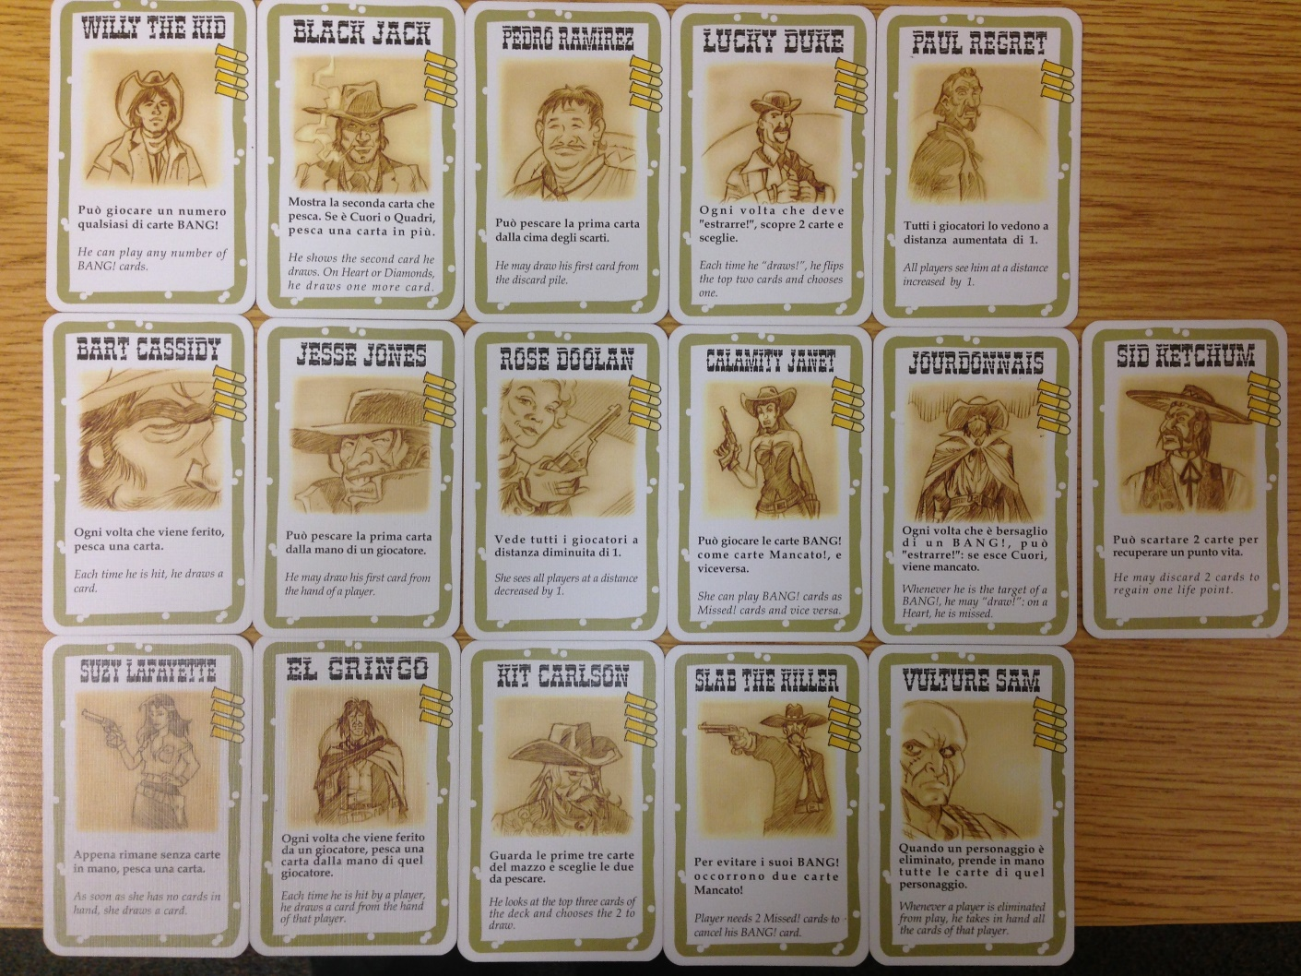
Areas of Future Inquiry
Addition of characters to game
Addition of characters to Alpha-Beta Pruning
Construction of Bayesian Belief Network
Addition of characters to Bayesian Belief Network

Slide 12
Questions?

